Slide 1
Uber Fares Analysis
presented by:
IRAKOZE TIMOTHEE

Slide 2
Introduction
This report presents a comprehensive analysis of Uber fare patterns and ride trends, leveraging the Uber Fares Dataset to uncover actionable insights. Using Power BI, we explore key metrics such as fare distributions, time-based demand fluctuations, and peak-hour pricing trends. The goal is to identify operational efficiencies, optimize pricing strategies, and enhance customer experience through data-driven decision-making.

Slide 3
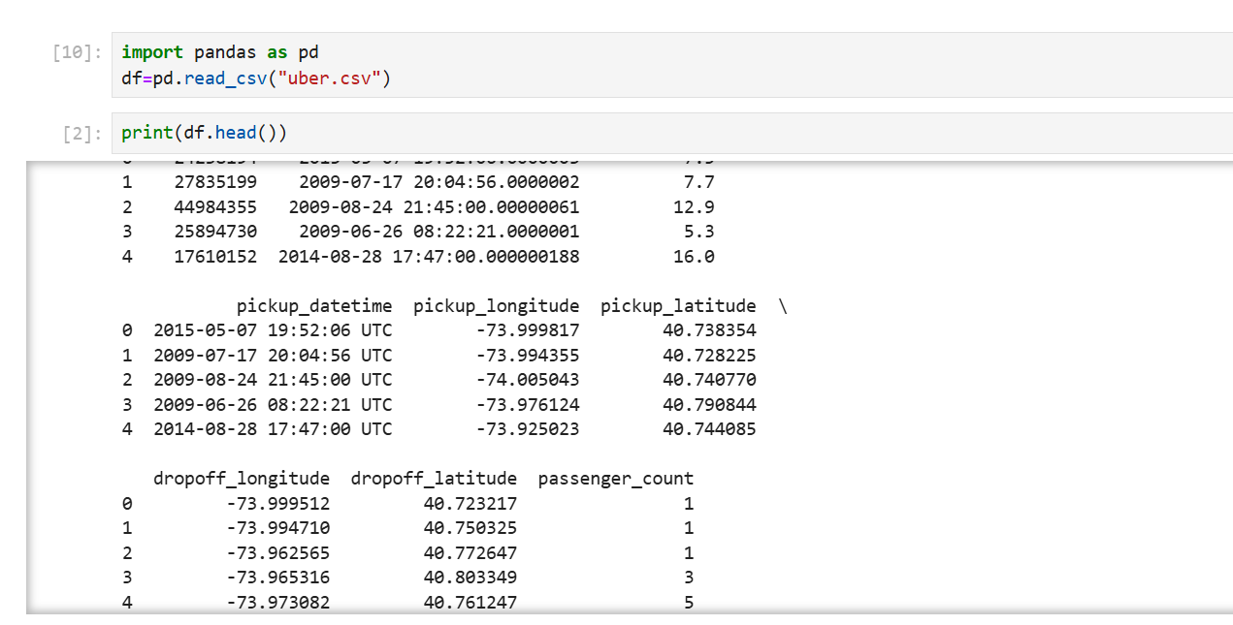

Slide 4
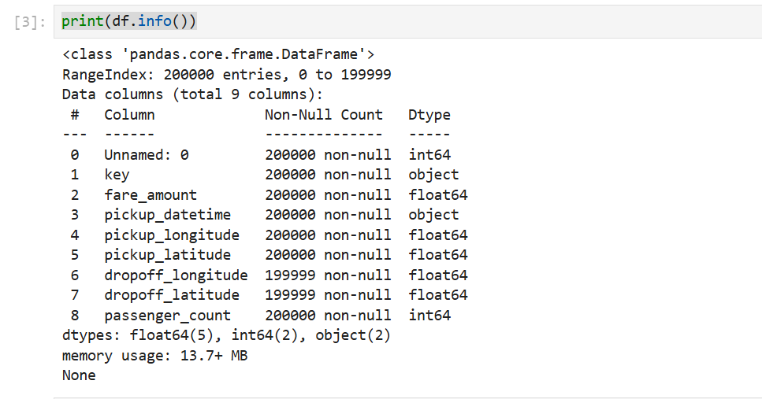

Slide 5
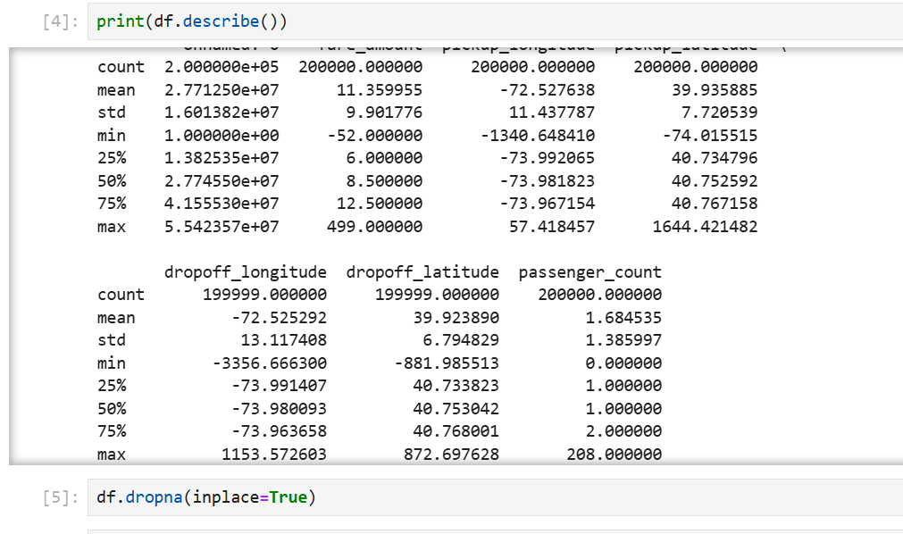

Slide 6
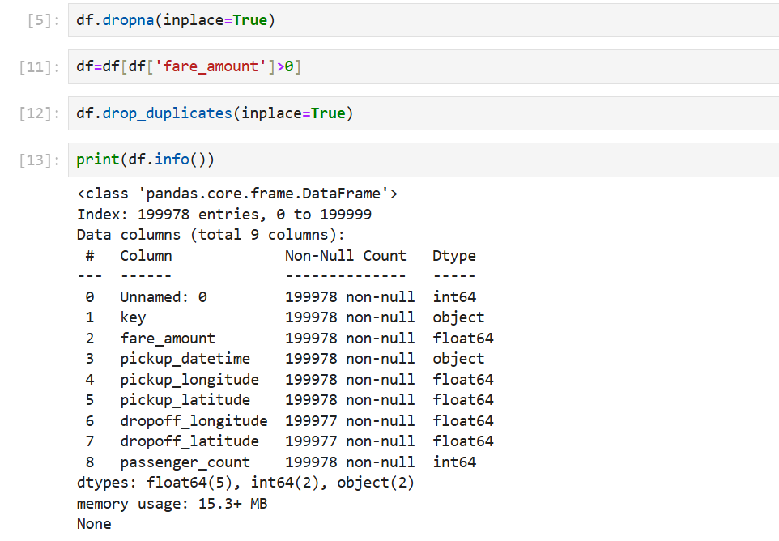

Slide 7
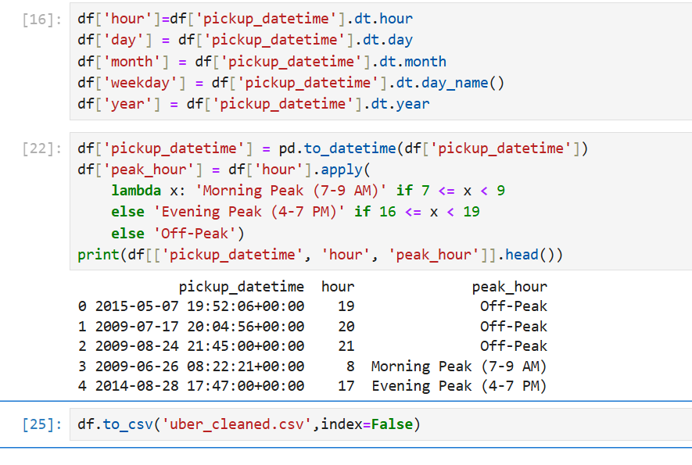

Slide 8
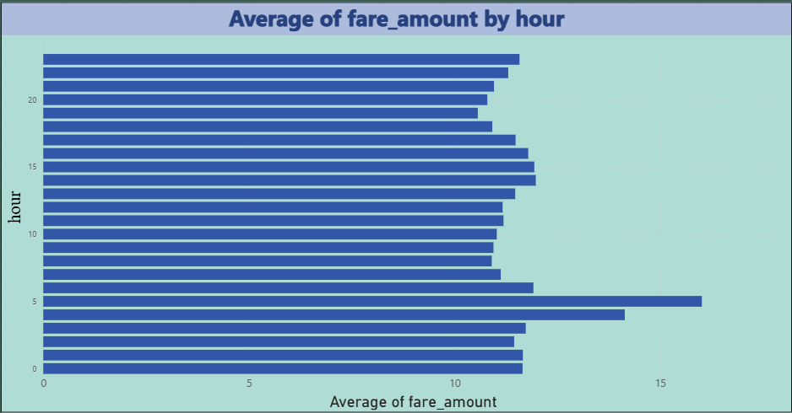

Slide 9
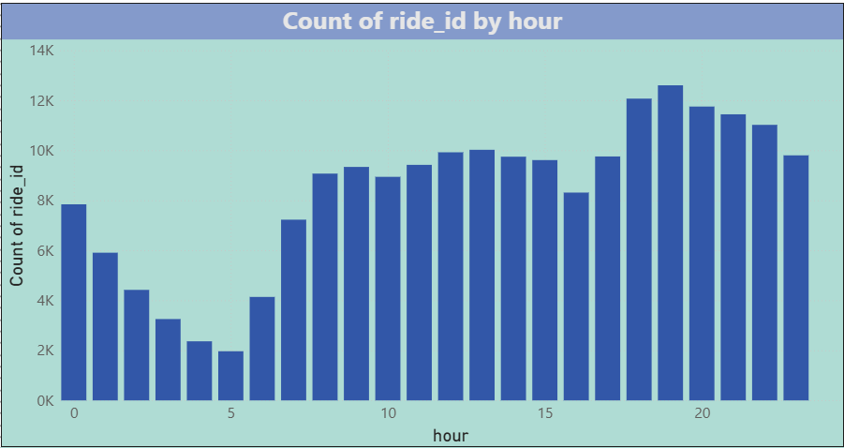

Slide 10
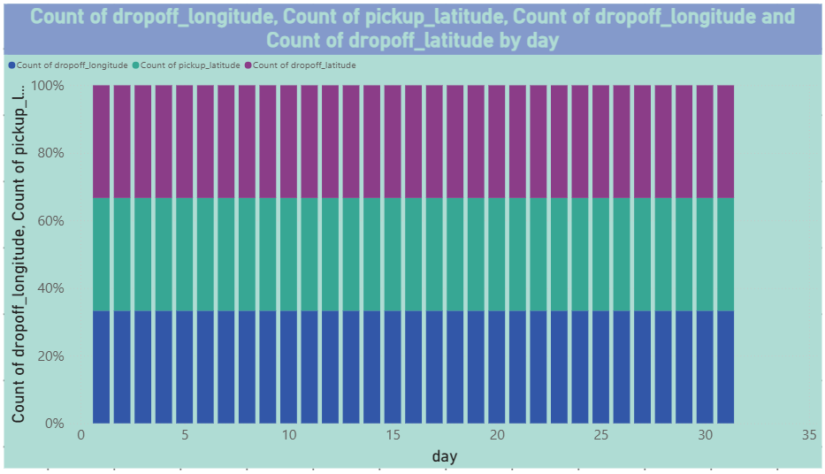

Slide 11
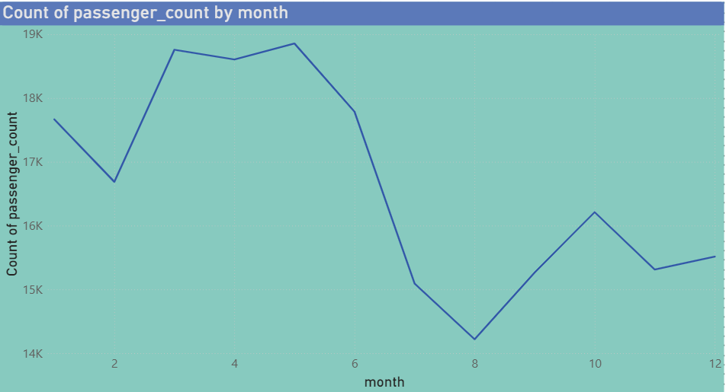

Slide 12


Slide 13
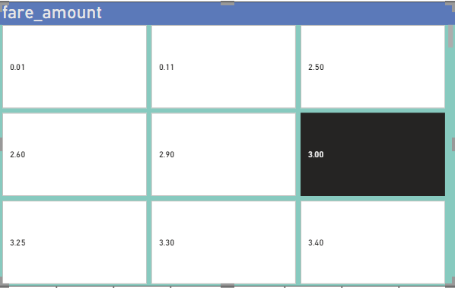

Slide 14
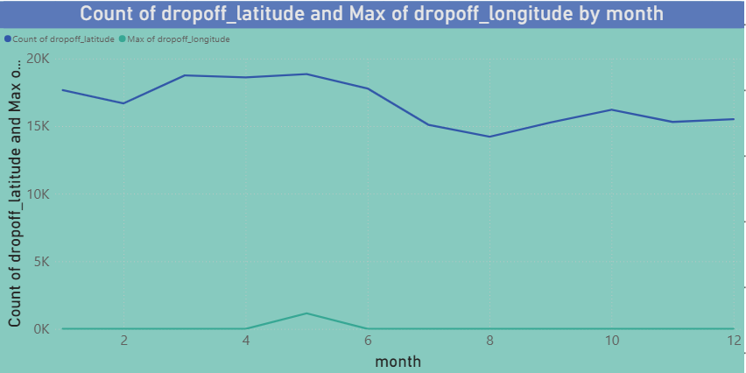

Slide 15
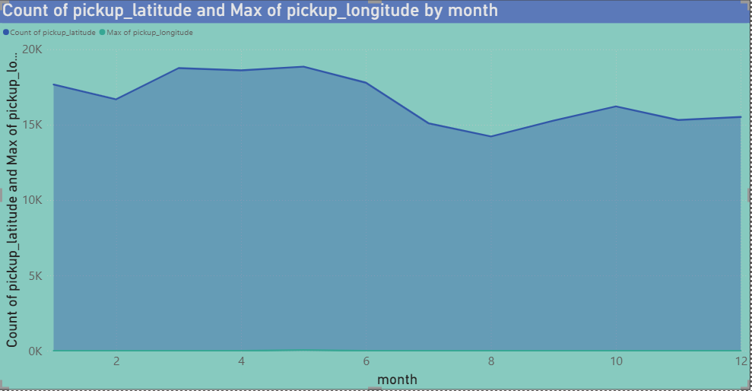

Slide 16
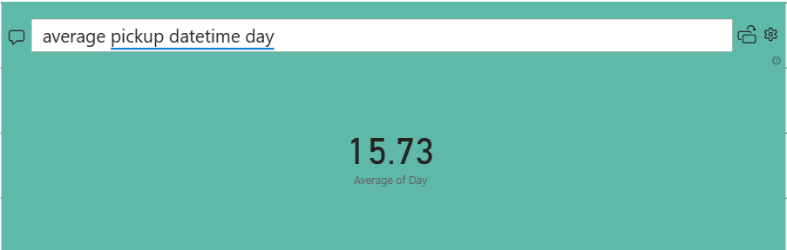

Slide 17
Conclusion
The analysis reveals critical patterns in Uber’s fare structure, including higher fares during peak hours (7–9 AM, 5–7 PM) and a strong correlation between trip distance and fare amounts. Geographic and temporal trends highlight opportunities for dynamic pricing adjustments and resource allocation. These insights empower Uber to refine pricing models, improve driver availability during high-demand periods, and boost profitability. For future work, integrating weather or traffic data could further enhance predictive accuracy.

